Slide 1

Analyzing Malicious and Benign Websites Dataset using Feed-Forward Neural Network Machine Learning for Cybersecurity Lecturer: Paata Gogishvili
Ghibradze, Gelashvili, Sakhvadze, Tchitchinadze, Burduli
Tbilisi, 8 may, 2024

Slide 2
Problem Description
Detecting and classifying malicious websites
Robust and adaptable detection mechanisms
Feed-forward neural networks enabling timely and accurate classification of websites as either benign or malicious

Slide 3
Dataset
“Malicious and Benign Websites” dataset was downloaded from the web-site: www.kaggle.com
https://www.kaggle.com/datasets/xwolf12/malicious-and-benign-websites

Slide 4
ML method
Feed-Forward Neural Networks are a fundamental type of artificial neural network architecture that has been widely studied and applied in various domains
Input layer
Hidden layers
Output layer
One of the key strengths of feed-forward neural networks lies in their ability to learn from data through a process called training
Feed-forward neural networks can be employed for a variety of tasks, including classification, regression, clustering, and pattern recognition
In the context of analyzing malicious and benign websites, feed-forward neural networks can be trained on a dataset containing features extracted from both types of websites

Slide 5
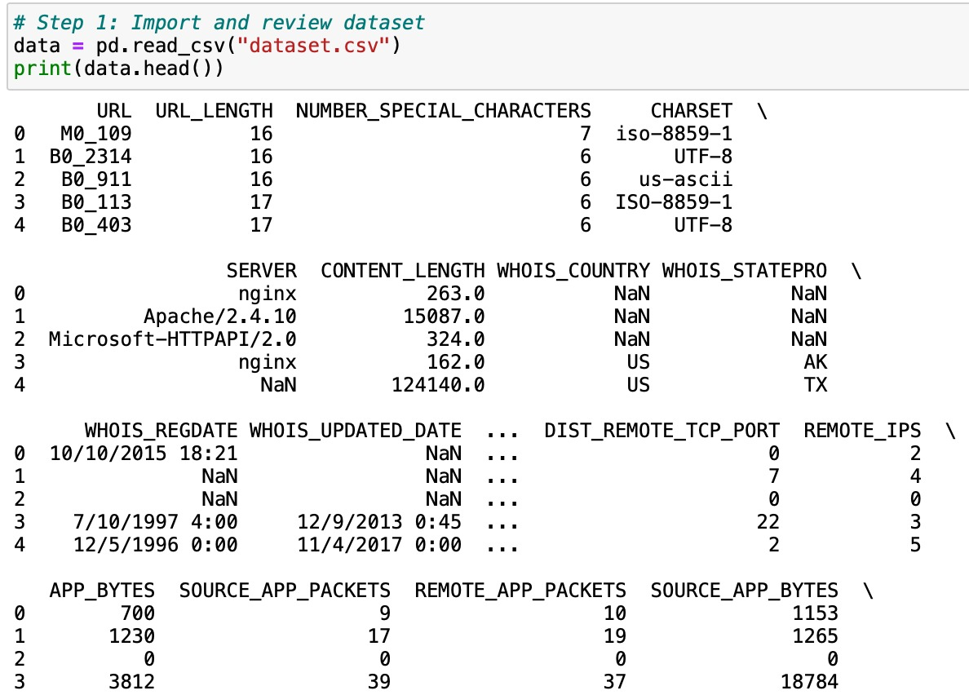
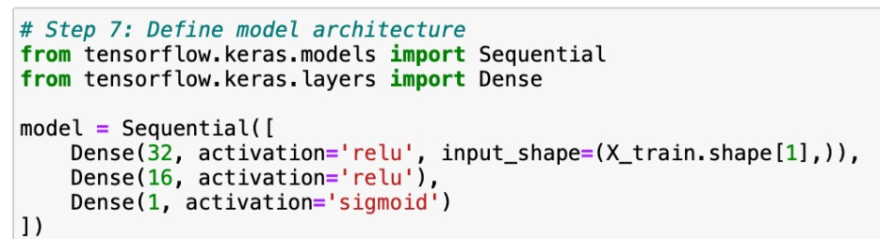
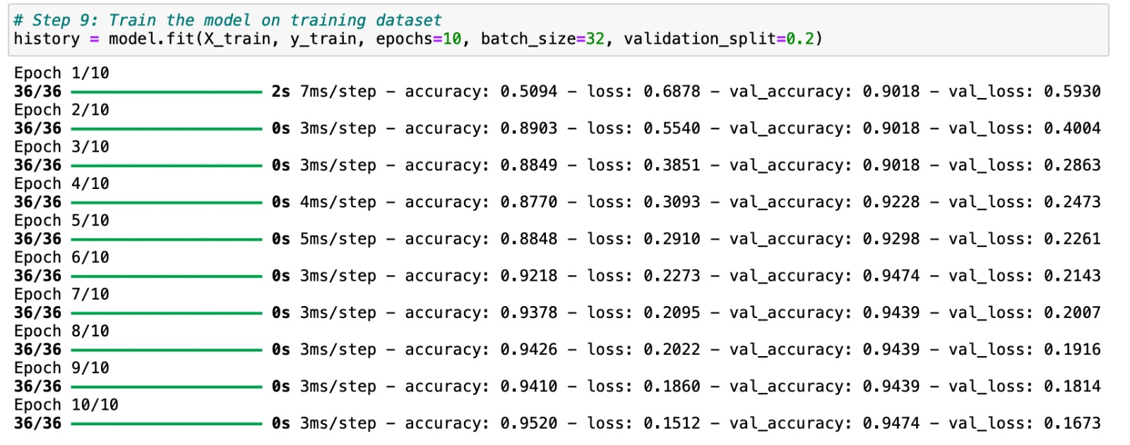
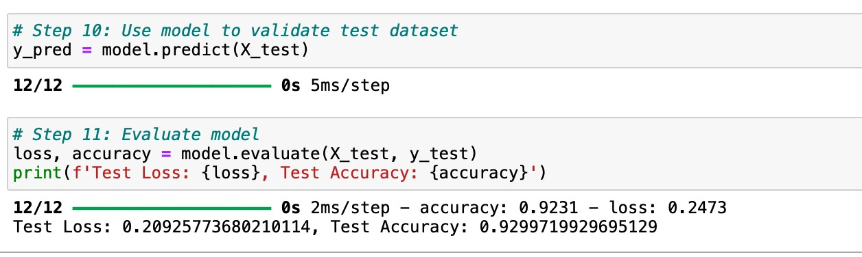
Python code
Import and review data set;
Remove individual and redundant features;
Encode categorical data;
Handle missing values - change "none" with data.median;
Normalize data;
Split dataset in training and test datasets;
Define model architecture;
Compile the model;
Train the model on training dataset;
Use model to validate test dataset;
Evaluate model;
Analyze test dataset using ROC/AUC, confusion matrix, predicting probability for test set, classification report;
Build plots illustrating analysis
Remove individual and redundant features;
Encode categorical data;
Handle missing values;
Normalize data;
Split dataset in training and test datasets

Slide 6
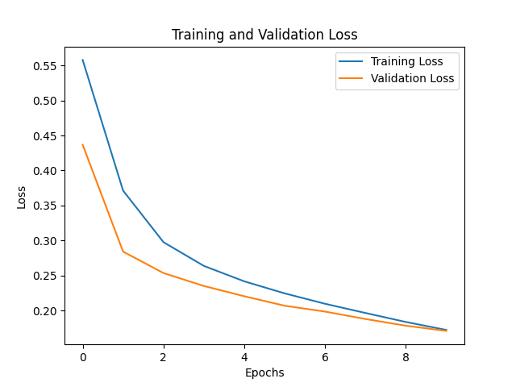
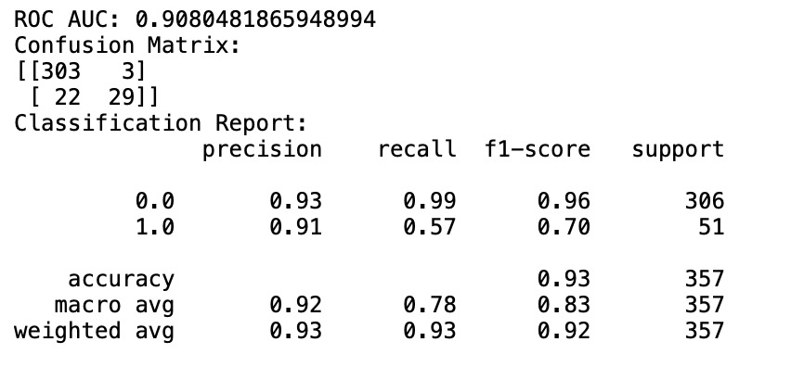
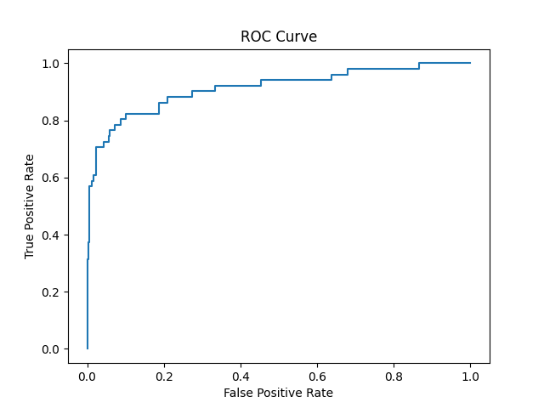
Results and Diagrams

Slide 7
Analysis
We have analyzed Malicious and Benign Websites dataset (downloaded from the www.kaggle.com), using the Feed-Forward Neural Network (FFN).
Source: https://www.kaggle.com/datasets/xwolf12/malicious-and-benign-websites
The initial dataset contained 21 columns (features) and 1782 rows (records).
Our Label was “Type”, a categorical variable, with values representing the type of web page analyzed: 1 is for malicious websites and 0 is for benign websites.
Overall, FFN has shown a high effectiveness, giving these scores:
Test Loss: 0.20925773680210114 Test Accuracy: 0.9299719929695129 ROC AUC: 0.9080481865948994

Slide 8
References
https://www.kaggle.com/datasets/xwolf12/malicious-and-benign-websites
https://claude.ai/chat/
https://chat.openai.com/

Slide 9
Thank You!

